Slide 1

Presented by Group 1

Slide 2





Team Members
Hanna Hsu
Daniel Lu
Candy Lin
Willis Hsiao
Sophomore in
Management Information Systems
Sophomore in
Management Information Systems
Sophomore in
Money and Banking
Sophomore in Public Finance

Slide 3
Summary
Problem
How to distribute the extra 300 patients to a doctor within their normal workload in a day while maintaining the accuracy of the diagnosis in 10 years according to SDG 3.1 ？
Suggestions
Outsource the diagnosis process to ASHA
Integrate MES (Medical Expert System) into Allogate platform

Slide 4
1.Problem Definition

Slide 5
Problem Definition
How to distribute the extra 300 patients to a doctor within their normal workload in a day while maintaining the accuracy of the diagnosis in 10 years according to SDG 3.1 ?
Problem Definition
Observation
Conclusion
Suggestions
Risk
Impact

Slide 6
2.Observation

Slide 7
Our observation towards the current system
ASHA’s physical visit and data record
Doctor’s feedback and prescription
ASHA’s nutrition distribution
Problem Definition
Observation
Conclusion
Suggestions
Risk
Impact

Slide 8
Main sources of competition in current system
Few competitors
Low threat of substitute products
Few entrants
High power of suppliers
Low power of customers
Though Allowear has high power of suppliers in the market, the quality of doctor is lower than expected. The doctor’s workload increases drastically.
Problem Definition
Observation
Conclusion
Suggestions
Risk
Impact

Slide 9
The reason why doctor’s workload increase
Why increase?
The creation and innovation of Allogate and Allowear
Deficiency of doctor supply
Doctor need to view extra more than 300 patients each day
Find out more high-risk expectant mothers which need doctor’s care
Problem Definition
Observation
Conclusion
Suggestions
Risk
Impact

Slide 10
3.Conclusion

Slide 11
Conclusion
In order to take care of all high-risk expectant mothers and maintain service quality, the doctor’s workload need to be decreased.
Problem Definition
Observation
Conclusion
Suggestions
Risk
Impact

Slide 12
4.Suggestions

Slide 13
4.1 Short-Term

Slide 14
How does the ASHA-training program work?
ASHAs voluntarily signs up for
pregnancy risk diagnosis program provided by DMHO
Doctors distribute risk diagnosis
patient cases to ASHAs who volunteers
ASHAs get paid by government per cases when visiting patients
Ways to teach ASHA’s workers
DMHO hires doctors
DMHO holds workshop
Problem Definition
Observation
Conclusion
Suggestions
Risk
Impact

Slide 15
How does money in the ASHA-training program flow?
Minimum Wage: 2000₹ per ASHA
for ASHAs
Government offer 2000₹
Current
Government Compensation
Distribution (per month)
Maximum Wage: 4000₹ per ASHA
for pregnant
mothers
10,000₹ per pregnant mother
10,000₹ per pregnant mother
7,000₹ per pregnant mother
for pregnant
mothers
New
Government Compensation
Distribution (per month)
Government take 3,000 ₹ to supplement ASHA
for ASHAS
Government can offer 5000₹ now
Problem Definition
Observation
Conclusion
Suggestions
Risk
Impact

Slide 16
How can ASHA-training program improve current system?
ASHA-training program
Increase ASHAs willingness to help
Help mitigate doctor’s workload
ASHAs can help a doctor review 300 patient datas a day
The addition 3000₹ budget can serve as an incentive for an ASHA
Reduce doctor’s workload to normal
Doctor can save more energy on other patients
Encourage more ASHAs to participate in the diagnosis learning plan
Problem Definition
Observation
Conclusion
Suggestions
Risk
Impact

Slide 17
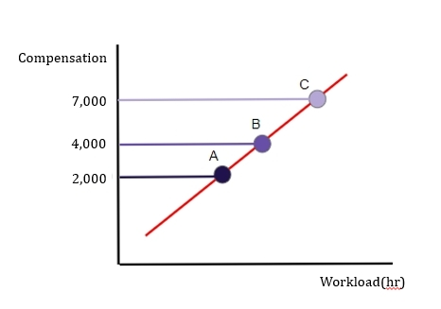
Marketing Plan to Increase the Workload of the ASHAs
In short-term, we pay the ASHAs in order to increase their willingness to work more. The extra ₹2,000 is paid by the DMHO. Besides, we plan to use ₹3,000 out of ₹10,000 which was given directly to the expectant mothers to be the extra compensation to the ASHAs. Therefore, with financial incentive they can help review the data of excess number of expectant mothers.
Problem Definition
Observation
Conclusion
Suggestions
Risk
Impact

Slide 18
4.2 Long-Term

Slide 19
How does the MES(Medical Expert System) work?
> 20 weeks
High-Risk
……
Gestation
>140/100 mmHg
Low-Risk
< 20 weeks
Blood Pressure
> 20 weeks
High-Risk
……
<140/100 mmHg
Gestation
< 20 weeks
Low-Risk
Problem Definition
Observation
Conclusion
Suggestions
Risk
Impact

Slide 20
Network Diagram of MES System
Gather Doctors’ Expertise
A
Engineer Build Database/Store Data
Integrate with User Interface
C
D
E
Build Inference Engine
B
Gather Medical Experts’ Expertise
Problem Definition
Observation
Conclusion
Suggestions
Risk
Impact

Slide 21
Gantt chart of MES system
Initial Project Timeline (in years)
Activities
1
2
3
4
5
6
7
8
Gather Doctors’ Expertise
Gather Medical Experts’ Expertise
Engineer Build Database/Store Data
Build Inference Engine
Integrate with User Interface
Problem Definition
Observation
Conclusion
Suggestions
Risk
Impact

Slide 22
How can MDS improve current system?
MDS
Better decision quality
Consistency
Speed
Reliability
Workload increase 20-30% per day, same as 300 patient. Which means a doctor has to scan through 1,000-1,500 patients data a day.
Help doctor conserve energy and reduce workload
Current System:3-Day Process
MDS can be performed at night.
The patients diagnosis can be gotten the next morning.
2
Downtime possibility low
1
ASHA capture data
Doctor provide feedbacks
3
ASHA visit patient with feedback
Improved System:2-Day Process
1
2
ASHA capture data
ASHA visit patient with feedback
Problem Definition
Observation
Conclusion
Suggestions
Risk
Impact

Slide 23
Main Budgets of Information System
Developments Costs
The system will need time and technology skills to develop.
Management Costs
After it is developed, it needs manpower to manage.
Time Costs
To the doctors, they need time to learn how to use it and get used to it.
Maintenance Costs
The system requires regular maintenance to make sure its accuracy.
Problem Definition
Observation
Conclusion
Suggestions
Risk
Impact

Slide 24
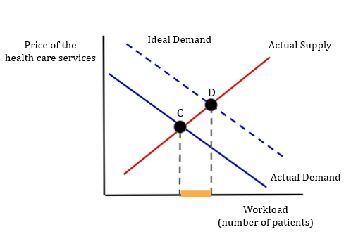
Decrease the Doctors Workload With Information System
Since doctors are fewer than patients, the actual equilibrium is limited by the number of doctors. However, consider the real demand of patients, if there are enough doctors, the equilibrium point should be D. The extra patients, where D minus C can be covered by the information system. So, the patients can receive care and the doctors do not need to do extra work.
Problem Definition
Observation
Conclusion
Suggestions
Risk
Impact

Slide 25
5.Risk

Slide 26
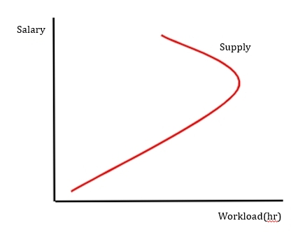
Short term Risk Mitigation-Market Plan
Backward-bending labor supply curve may happened with a given labor market.
Higher compensation may attract more people to join the ASHAs. Therefore, although the effect of raising compensation is limited for those who were already in the ASHAs, the whole supply can still increase when more people join this labor market.
Problem Definition
Observation
Conclusion
Suggestions
Risk
Impact

Slide 27
Long Term Risk Mitigation – Marketing Plans
Loss of control of the data which may causes data loss or stolen.
Ask the AHSA to backup the data when they proceed with the rest of data collection with Hard Disk Drive.
Problem Definition
Observation
Conclusion
Suggestions
Risk
Impact

Slide 28
Long Term Risk Mitigation-Accuracy Plans
Some health problem cannot be observe just by a single standard.
The system will include not only one criteria to capture a more precise and complete health image of the patient.
Problem Definition
Observation
Conclusion
Suggestions
Risk
Impact

Slide 29
Long Term Risk Mitigation-Market Entry
The doctor might not want to trust the new information system.
A complete education system is required to instruct the doctor about this system.
Problem Definition
Observation
Conclusion
Suggestions
Risk
Impact

Slide 30
6.Impact

Slide 31
What To Do after Implementing the Long-Term Plans
Install the Pregnancy Risk diagnosis Expert System in Allogate.
Help the doctor get familiarize with the system through instructions classes
Maintenance and repair the system every year
Problem Definition
Observation
Conclusion
Suggestions
Risk
Impact

Slide 32
Overall Impacts
Short-term Plan
Long-term Plan
Outsource the diagnosis process to ASHA
Integrate MES (Medical Expert System) into Allogate platform
The government’s approval
AHSA’s cooperation
DMHO’s assist
Doctor’s familiarization of the process
IS developer
AHSA’s cooperation
Doctor’s familiarization of the System
six years
Problem Definition
Observation
Conclusion
Suggestions
Risk
Impact

Slide 33
Q&A

